Slide 1
Runtime Memory

Slide 2
Basic Knowledge
In any programming language programme will be stored in hard disk.
But to execute that code by CPU the code should be present in the main memory.
Then after compilation compiler will demand a block of memory from memory in order to store the code.
Here OS is responsible for the managing the resources like allocation of memory and processor.
So now to know about how programme is stored in the memory at the time of execution a concept is used which is Runtime Storage.

Slide 3
Runtime Memory
It is the structure of the target computers registers and memory
It serves to manage memory and maintain information.
When the target program executes then it runs in its own logical address space.
The logical address space is shared among the Compiler, OS and Target Machine for management and organization.
The operating system is used to map the logical address into physical address which is usually spread throughout the memory.

Slide 4
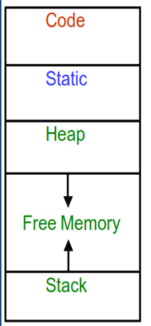
Runtime Memory

Slide 5
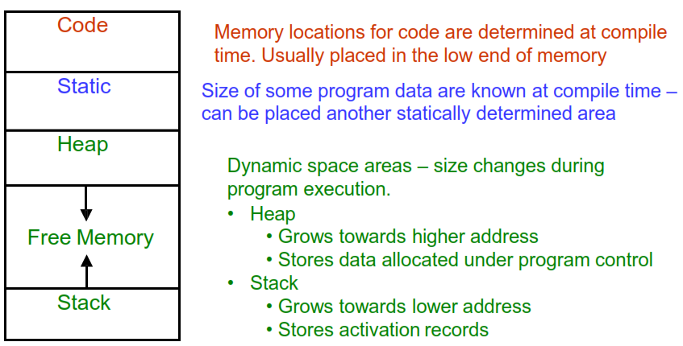
Subdivision of Runtime memory

Slide 6
The size of some program objects may be known at run time and may be placed in an area called static.
The dynamic areas used to maximize the utilization of space at run time are stack and heap.

Slide 7
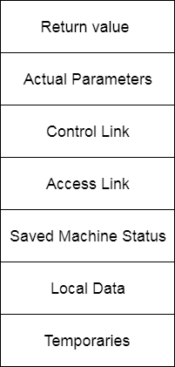
Activation Record

Slide 8
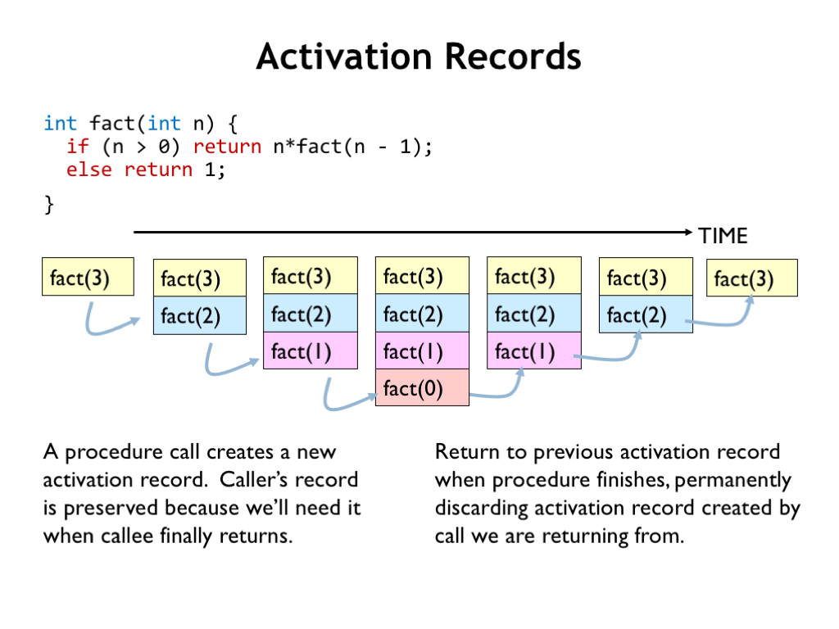
Example:

Slide 9


